Slide 1






Lecture 28:
useEffect Hook
& Lifecycle Methods
Course - Web Development - II
-By
Instructor Name
1
welcome@krmangalam.edu.in
Sohna Road,Gurugram,Haryana 122103

Slide 2

| Table of Contents
Component Lifecycle
useEffect
Cleanup Function
Fetching Data with useEffect
References.
The End.
2

Slide 3

|
Did you know React components are just like humans – they are born, they live and change, and finally, they die?
3

Slide 4

|
Did you know React components are just like humans – they are born, they live and change, and finally, they die?
In React, every component has a lifecycle.
You can imagine it just like a human’s life:
Birth
A baby is born.
Similarly, when a component is created and added to the screen, this is its birth.
Growth
A human grows, learns new things, and changes over time.
Similarly, a component updates whenever its data (props or state) changes.
Death
Every human has an end.
Similarly, when a component is removed from the screen, its lifecycle ends.
4

Slide 5
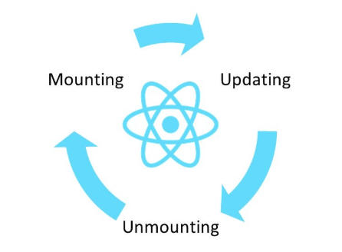
| Component Lifecycle
A component lifecycle in React refers to the different stages a component goes through from its creation to its removal from the user interface.
Birth —> growth —> death
It is divided in three main phases:
Mounting (Birth): The component appears on the screen for the first time.
Updating (Growing ): The component changes because its state or props changed.
Unmounting (Death) :The component is removed from the screen, so we must clean up.
5

Slide 6
| Mounting
Mounting is the process when a component is created and inserted into the DOM (Document Object Model) for the very first time.
This is the "birth" of a component.
Example:
When you open a website and the homepage content appears for the first time.
6

Slide 7
| Updating
Updating happens when a component is already present in the DOM, but it is re-rendered because either its props or state has changed.
This is the "growth/change" stage of a component.
Example:
When you type in a search box and the search results update on the screen.
7

Slide 8
| Unmounting
Unmounting is the process when a component is removed from the DOM.
This is the "end/death" of a component’s lifecycle.
Example:
When you close a popup window or navigate away from a page, the component is unmounted.
8

Slide 9
|
Did you know the three phases (Mounting, Updating, Unmounting) were once handled using special names in Class Components.
9

Slide 10
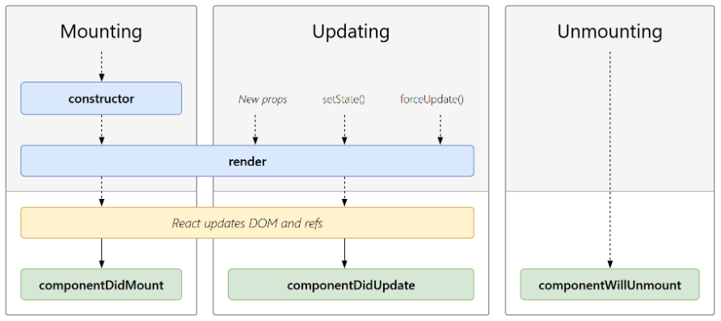
|
Did you know the three phases (Mounting, Updating, Unmounting) were once handled using special names in Class Components.
In Class Components, React gave us different lifecycle methods for each phase.
It had separate functions for Birth, Change, and Death.
Mounting (Birth) →componentDidMount()
Runs once after the component is shown on screen.
Updating (Change) → componentDidUpdate()
Runs whenever state or props change.
Unmounting (Goodbye) → componentWillUnmount()
Runs just before the component is removed from the screen.
10

Slide 11

|
Have you ever wondered… in Function Components, we don’t have so many different lifecycle methods like in Class Components. Then how do we handle the lifecycle? What if I tell you we have just one magic tool that makes the whole lifecycle super easy?
11

Slide 12
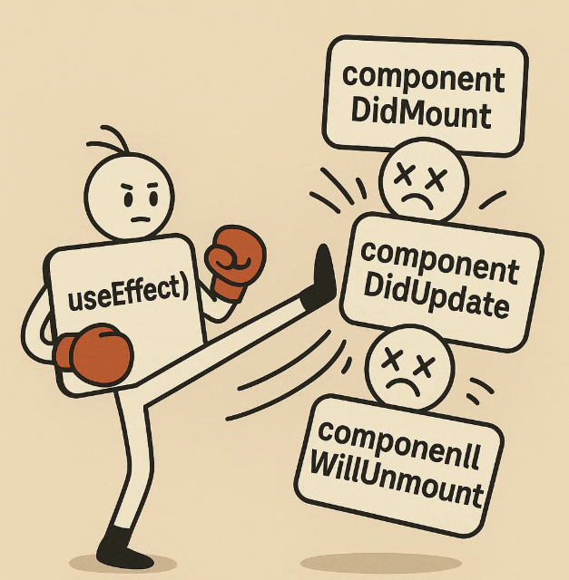
|
Have you ever wondered… in Function Components, we don’t have so many different lifecycle methods like in Class Components. Then how do we handle the lifecycle? What if I tell you we have just one magic tool that makes the whole lifecycle super easy?
We have one master key → useEffect().
It replaces all the lifecycle methods of Class Components.
useEffect() = Mount + Update + Unmount in one simple function.
12

Slide 13
| useEffect()
useEffect() is a Hook that allows to run side effects in function components.
A side effect is any action that happens outside the normal rendering process,
for example:
Fetching data from an API
Updating the browser DOM manually
Setting up timers
Logging values
Cleaning up resources
13

Slide 14
| useEffect()
It lets you execute code whenever the component:
Mounts → When the component first appears on the screen.
Updates → When state or props change.
Unmounts → When the component is removed from the screen.
14

Slide 15
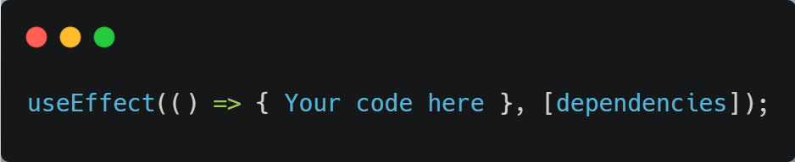
| useEffect()
Syntax :
A function that contains your effect logics, it runs after the component renders.It also has Return function for Cleanup logic (optional)
dependency array → tells React when to run the function.
15

Slide 16
| useEffect()
Different Ways of Using useEffect :
1. Run After Every Render
If you don’t give a dependency array, useEffect will run after every render — when the component first loads and every time it updates.
Example :-
Like a teacher taking attendance every single time the class changes
16

Slide 17
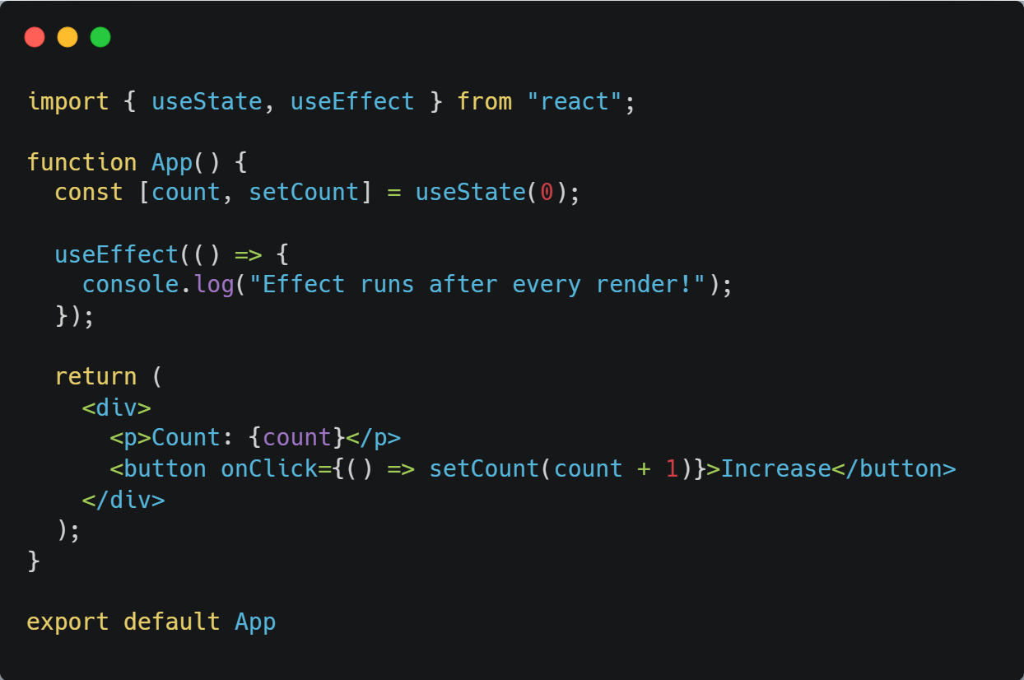
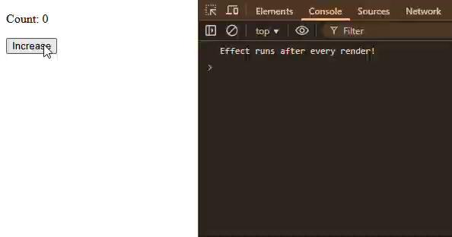
| useEffect()
17

Slide 18
| useEffect()
2. Run Only Once
If you pass an empty array [], the effect will run only one time when the component is born (mounted).
Often used for fetching data from an API.
18

Slide 19
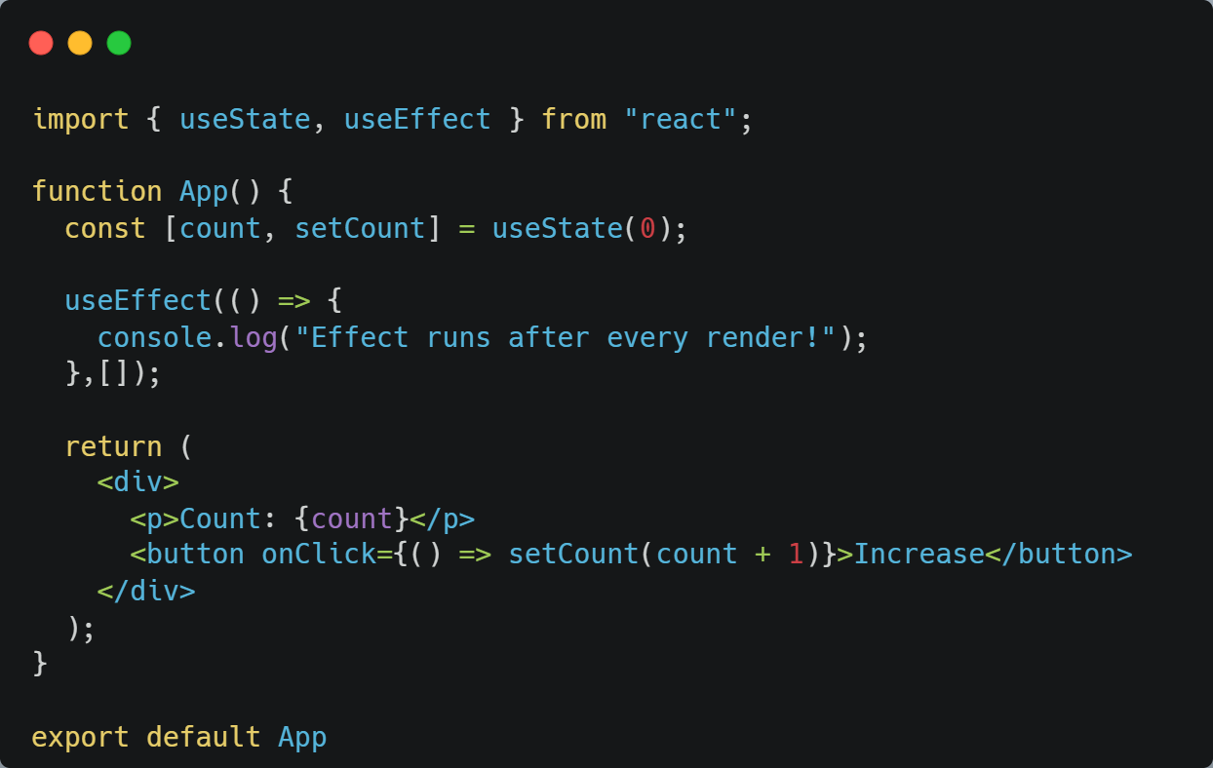
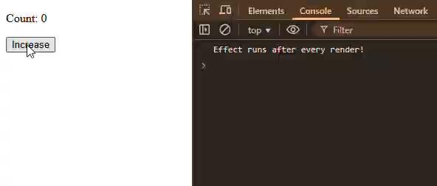
| useEffect()
19

Slide 20
| useEffect()
3. Run When Specific Data Changes
If you add variables inside the dependency array, the effect runs once when the component first renders, and then runs again only when those variables change.
Example :- Like a weighing machine — the display updates only when your weight changes.
20

Slide 21
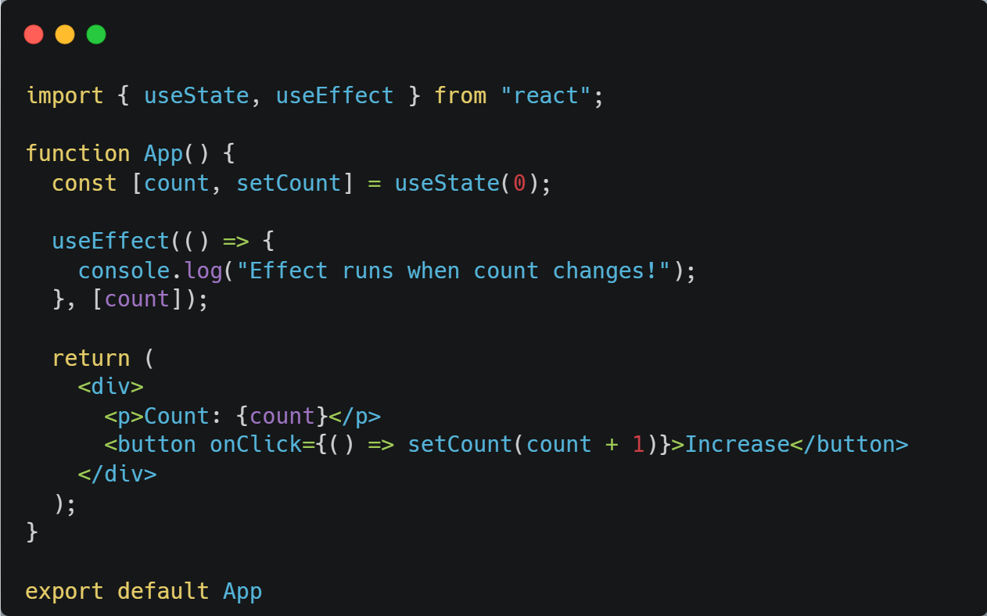
| useEffect()
21

Slide 22

| Coding Questions
1. Running an Effect Once
Task : Create a WelcomeMessage component. Use the useEffect Hook to log the message
"Component has mounted!" to the console only once when the component first renders.
22

Slide 23
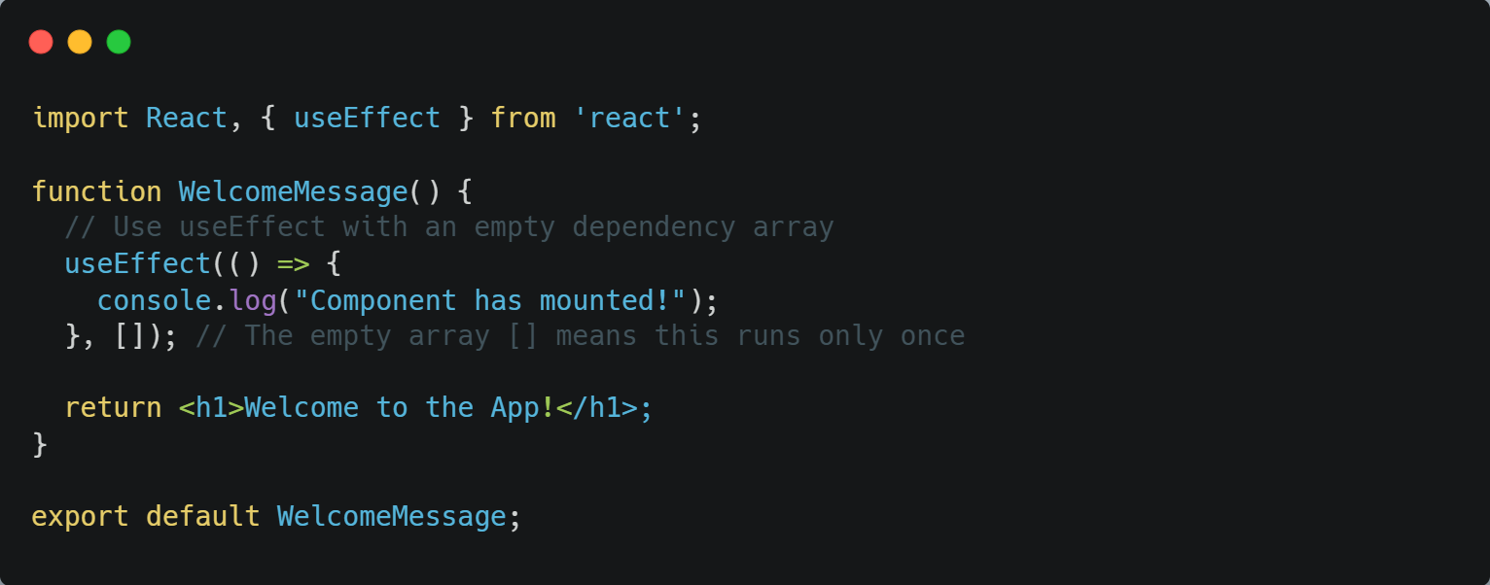
| Coding Questions
Solution:
23

Slide 24
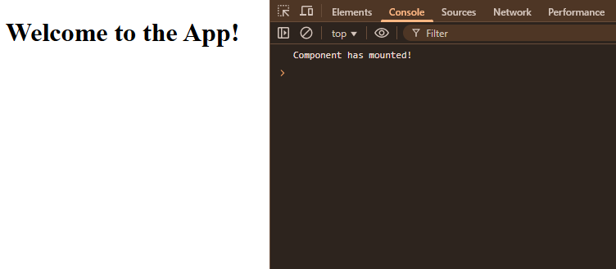
| Coding Questions
Output :
24

Slide 25
|
Did you know if I put a heavy function (something that takes a lot of time, like a big loop or an API call) inside useEffect and then remove the component from the UI — will that function still run? What happens then? Is that good practice?
25

Slide 26
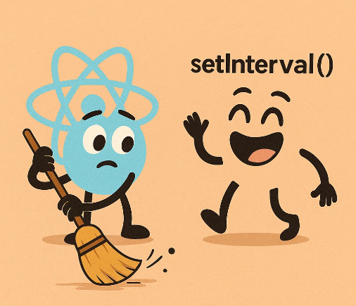
|
Did you know if I put a heavy function (something that takes a lot of time, like a big loop or an API call) inside useEffect and then remove the component from the UI — will that function still run? What happens then? Is that good practice?
Yes — if a heavy function (like a long loop or a slow API call) has already started inside useEffect, it will keep running even if the component is removed from the UI. React does not have the power to “kill” or “stop” JavaScript code that has already begun execution.
However, this is not good practice because It can waste memory and slow performance
But A big thanks to the cleanup function — it makes sure React components leave no mess behind when they disappear.
26

Slide 27
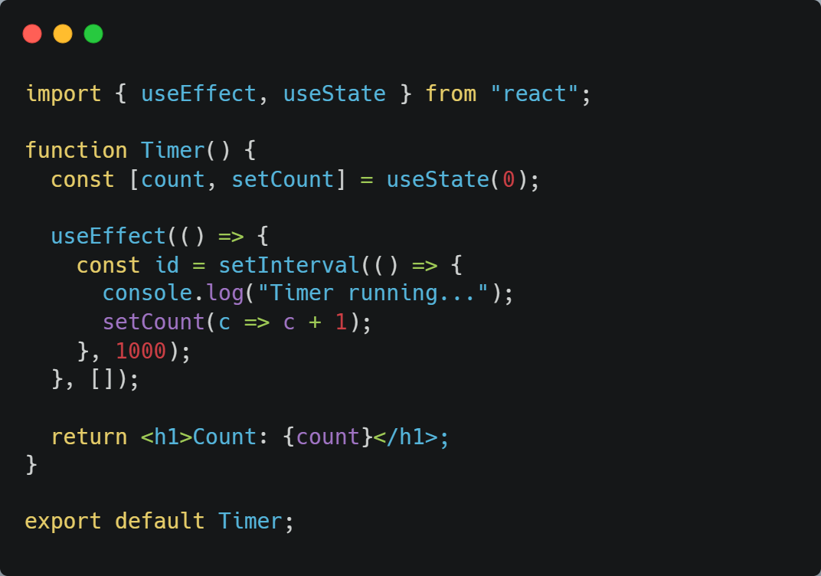
| cleanup function
Problem Without Cleanup
If the component is unmounted (e.g., when the page changes), the interval will still keep running.
This can lead to memory leaks and unnecessary performance issues.
27

Slide 28
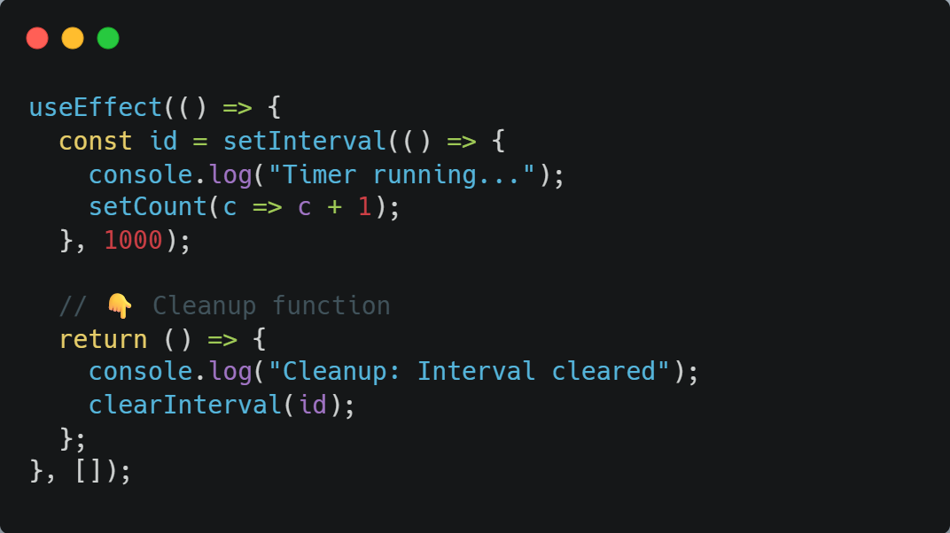
| cleanup function
Solution: Cleanup Function
The code inside return () => { ... } will run when the component unmounts, and this code will stop the interval.sues.
28

Slide 29
|
Did you know when the dependency array value changes, React will first run the cleanup function, and then run the new effect.
29

Slide 30
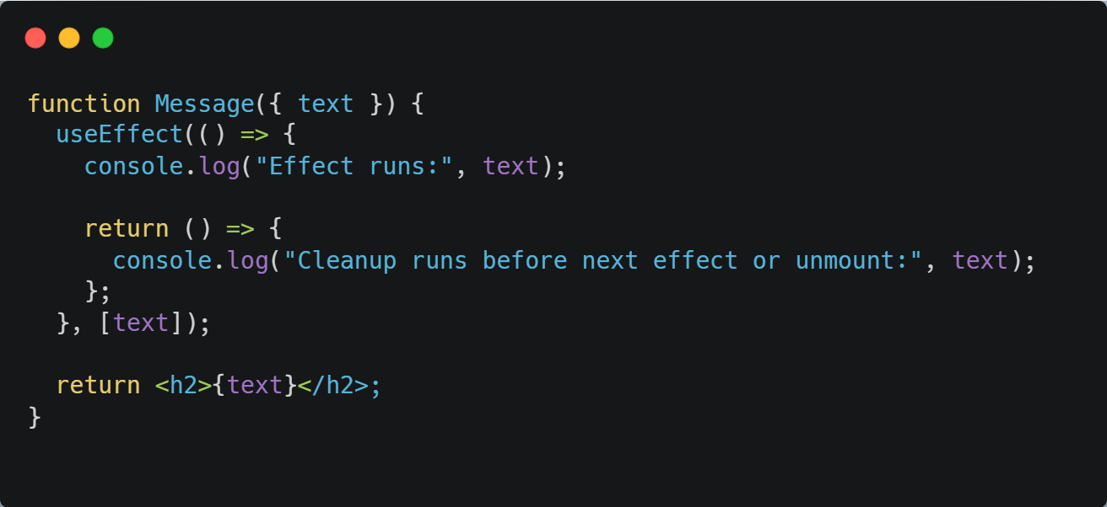
| cleanup for dependency array
When the text prop changes:
React first calls the cleanup function for the old value of text.
Then React runs the effect again for the new value of text.
dependency array
30

Slide 31
|
Have you ever wondered why data fetching is also considered a side effect? Imagine if we place a fetch call directly in the component body — it will run again and again every time the component re-renders. Do we really want that?
31

Slide 32
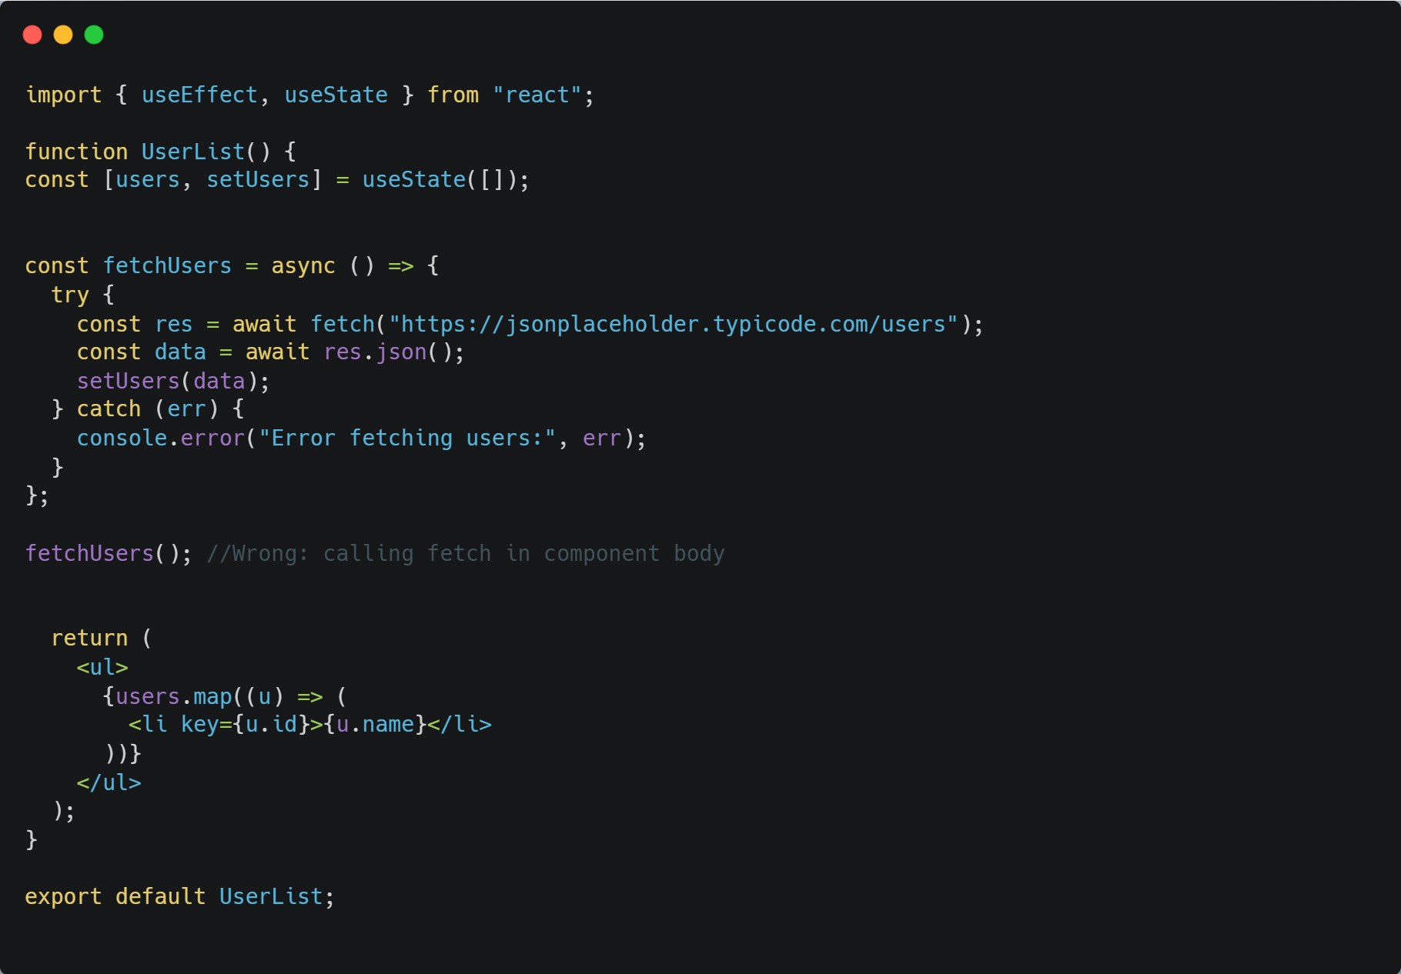
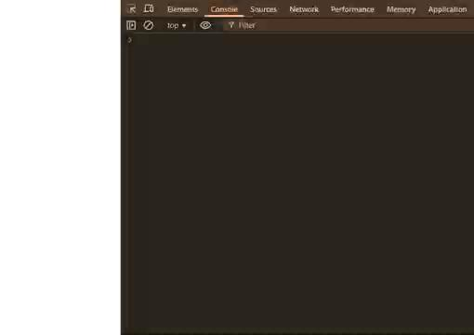
|
Have you ever wondered why data fetching is also considered a side effect? Imagine if we place a fetch call directly in the component body — it will run again and again every time the component re-renders. Do we really want that?
If we write like this for fetching data: This can cause infinite loops or unnecessary API calls.
32

Slide 33

|
Have you ever wondered why data fetching is also considered a side effect? Imagine if we place a fetch call directly in the component body — it will run again and again every time the component re-renders. Do we really want that?
No, we don’t want this. If a fetch call runs on every render, it will keep hitting the API again and again, causing unnecessary network calls and slowing down the app.
Big thanks to useEffect — it gives us a safe place to perform data fetching.
33

Slide 34
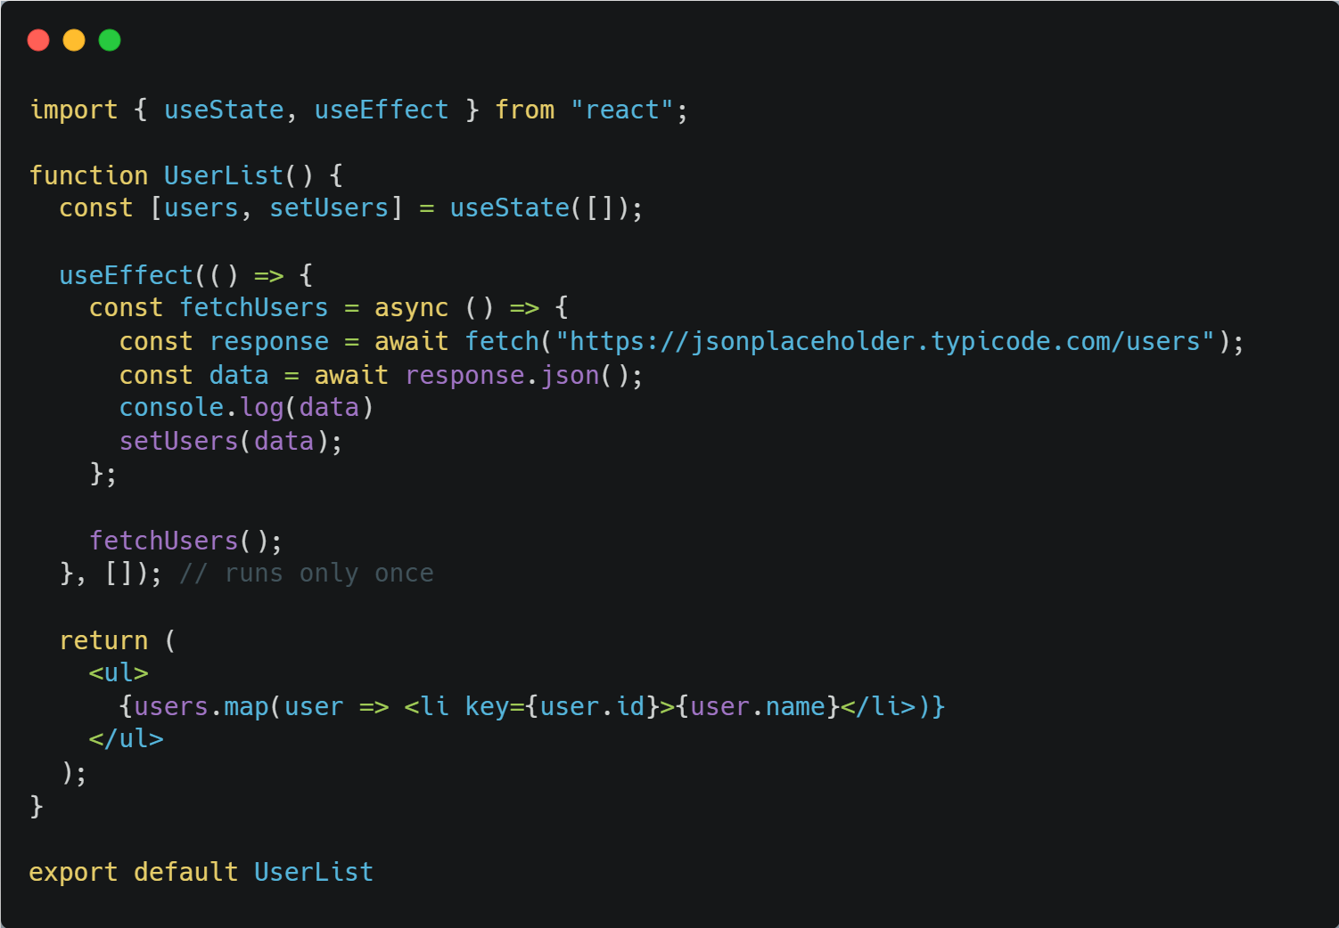
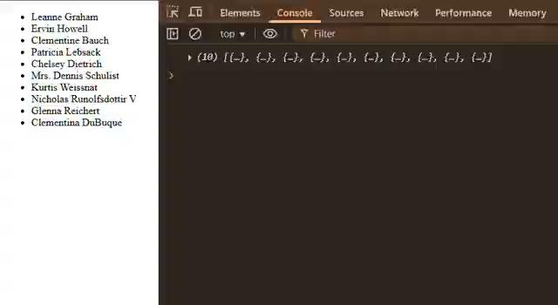
| Fetching Data with useEffect
Call the function inside useEffect with an empty dependency array [].
Empty array means: run this effect only once when the component mounts.
34

Slide 35
| Coding Questions
2. Fetching Data with useEffect
Task : Create a TodoItem component that fetches and displays a single "todo" item from the
JSONPlaceholder API when it mounts.
Use useState to store the todo data.
Use useEffect to fetch the data from https://jsonplaceholder.typicode.com/todos/1.
Update the state with the fetched data.
Display the todo's title.
35

Slide 36
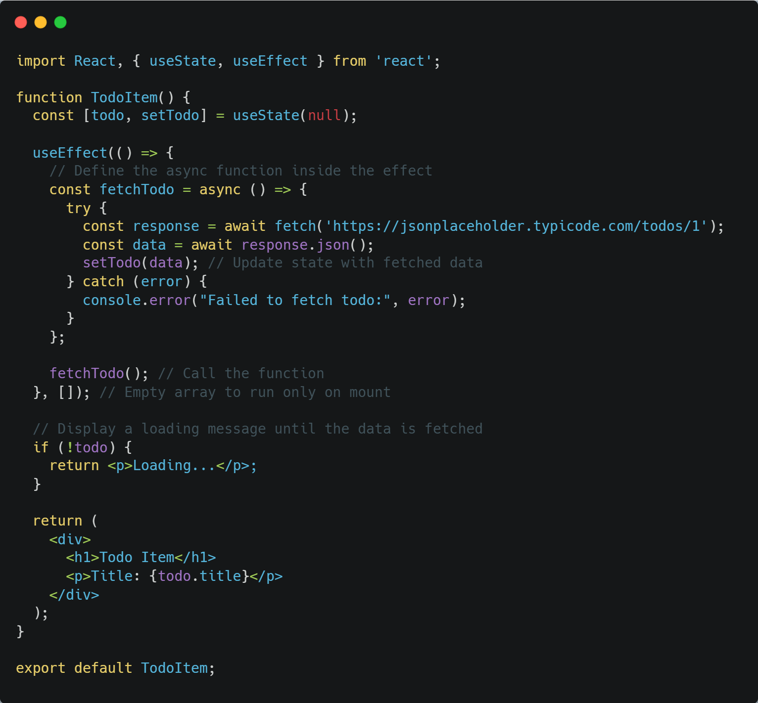
| Coding Questions
Solution:
36

Slide 37

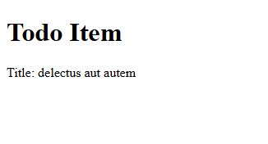
| Coding Questions
Output :
Output
Output
API Data fetching…
API Data fetched
37

Slide 38
| Check Your Understanding
Question : What is a "side effect" in a React component?
Options : a) An unexpected bug in the code.
b) Any interaction with the "outside world" from within your component, like fetching data or setting a timer.
c) A function that changes the component's state.
d) The process of passing props to a child component.
Answer : b) Any interaction with the "outside world" from within your component, like
fetching data or setting a timer.
Explanation:
Side effects are operations that are not directly related to rendering the UI, such as API calls, subscriptions, or manually manipulating the DOM. The useEffect Hook is the primary tool for managing them.
38

Slide 39
| Check Your Understanding
Question : Which React Hook is used to perform side effects in functional components?
Options : a) useState
b) useEffect
c) useContext
d) useReducer
Answer : b) useEffect
useEffect allows you to run code with side effects in response to a component rendering or specific state/prop changes.
Explanation:
39

Slide 40
| Check Your Understanding
Question : In useEffect(() => { ... }, []);, what does the empty dependency array [] signify?
Options : a) The effect will run after every render.
b) The effect will not run at all.
c) The effect will run only once, after the component's initial render (mount).
d) The effect will run when the component is removed from the DOM.
Answer : c) The effect will run only once, after the component's initial render (mount).
Explanation:
An empty dependency array tells React that the effect does not depend on any props or state, so it should only be executed once when the component first mounts. This is ideal for initial data fetching.
40

Slide 41
| Check Your Understanding
Question : What is the main purpose of the cleanup function returned from useEffect?
Options : a) To clean up resources and prevent memory leaks before the component unmounts or the effect re-runs.
b) To reset the component's state.
c) To log an error message if the effect fails.
d) To return a value from the effect.
Answer : a) To clean up resources and prevent memory leaks before the component unmounts
or the effect re-runs.
Explanation:
The cleanup function is crucial for canceling subscriptions, clearing timers (clearInterval), or stopping any other ongoing processes that the effect started, ensuring they don't continue to run after the component is gone.
41

Slide 42
| Check Your Understanding
Question : If you have useEffect(() => { ... }, [count]);, when will the effect's callback function be executed?
Options : a) Only once, when the component mounts.
b) After every single render of the component.
c) When the component mounts, and then again anytime the count state variable changes.
d) Only when the count state variable changes, but not on the initial mount.
Answer : c) When the component mounts, and then again anytime the count state variable
changes.
Explanation:
The dependency array tells React to re-run the effect if any of the values inside the array have changed between renders. It always runs on the initial mount as well.
42

Slide 43
| References
MDN Web Docs : Comprehensive and official documentation for JS. 🔗https://developer.mozilla.org/en-US/docs/Web/JavaScript
W3Schools – JS Tutorial : Beginner-friendly JS tutorials with examples and interactive editors. 🔗 https://www.w3schools.com/js/
react.dev - A comprehensive, tutorial-style website that deeply explores core React concepts, including components, state, effects, and hooks, through interactive examples and in-depth explanations.
🔗https://react.dev/
43

Slide 44
Thanks
For
Watching
Course - Web Development - II
44
welcome@krmangalam.edu.in
Sohna Road,Gurugram,Haryana 122103

